Slide 1
Changing the Digital Climate
How Climate Change Web Content is Being Censored Under the Trump Administration
2019-02-27
Puneeth Bikkasandra
CS795/895
@PuneethBikks
@WebSciDL

Slide 2
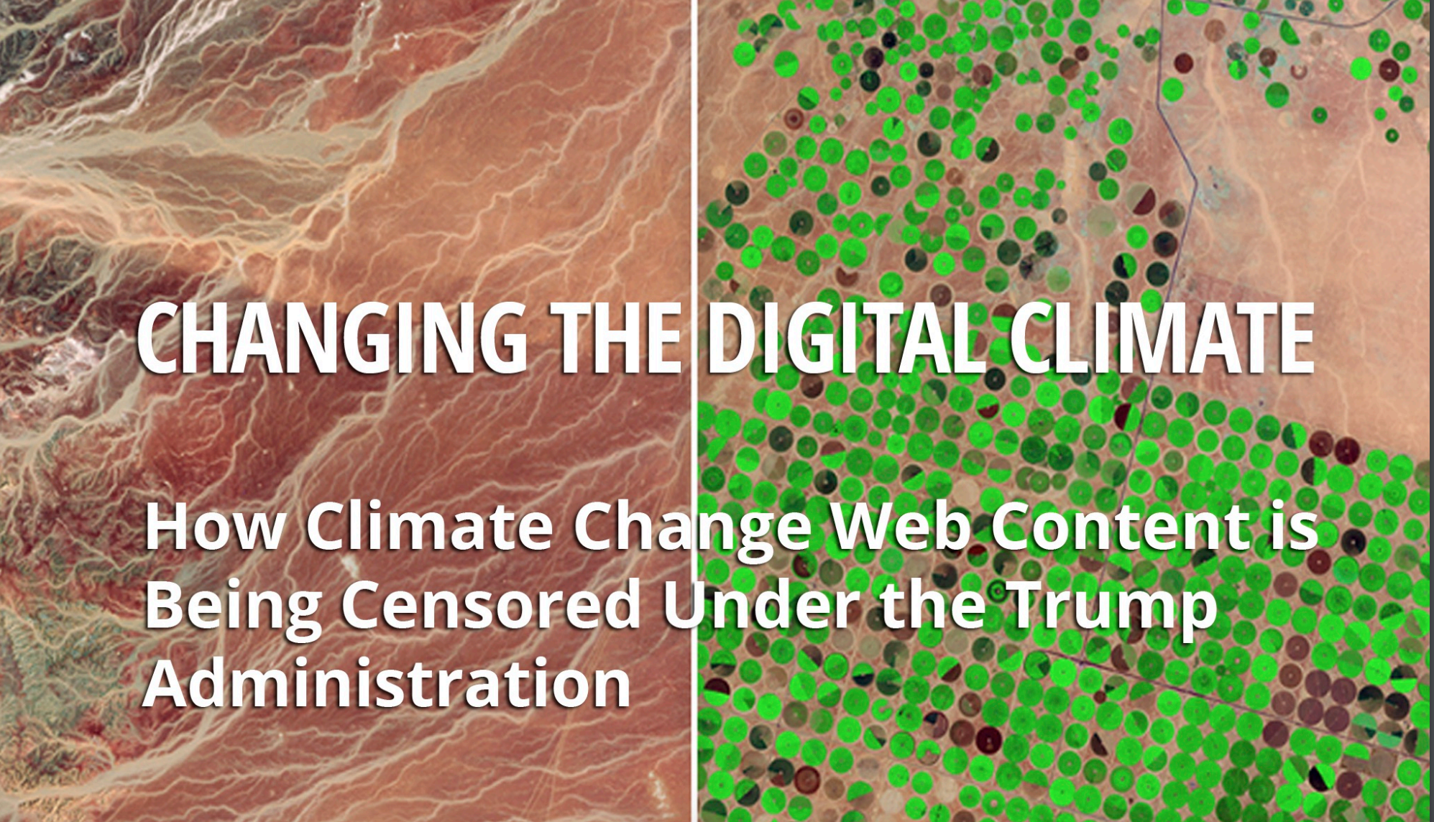
https://envirodatagov.org/wp-content/uploads/2018/01/Part-3-Changing-the-Digital-Climate.pdf#page=15&zoom=100,0,374

Slide 3
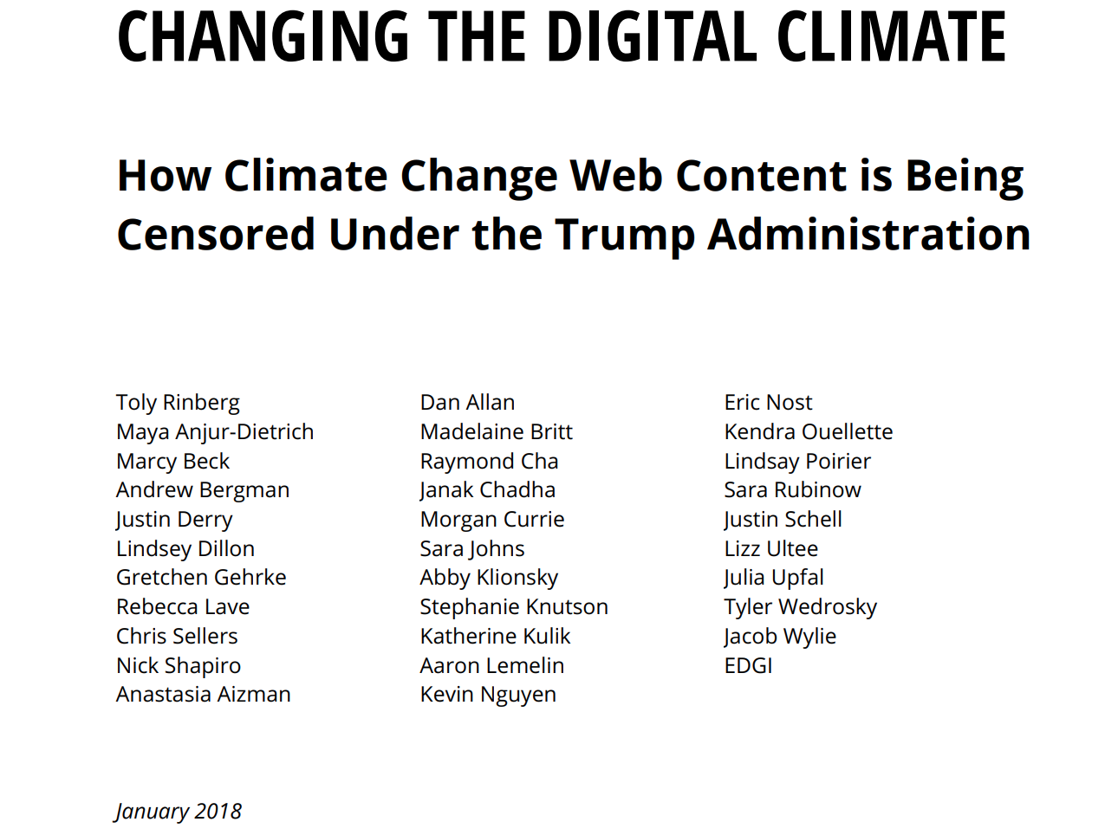
https://envirodatagov.org/wp-content/uploads/2018/01/Part-3-Changing-the-Digital-Climate.pdf#page=15&zoom=100,0,374

Slide 4
Climate Change:
Earth’s climate is constantly changing over geological time, where the global average temperature is 59F. Geological evidence confirms much higher and lower temperatures in the past.
Greenhouse Effect:
Earth's atmosphere traps some of the energy from the Sun. Solar energy radiating back out to space from the Earth's surface is absorbed by atmospheric greenhouse gases and re-emitted in all directions.
https://www.bbc.com/news/science-environment-24021772

Slide 5
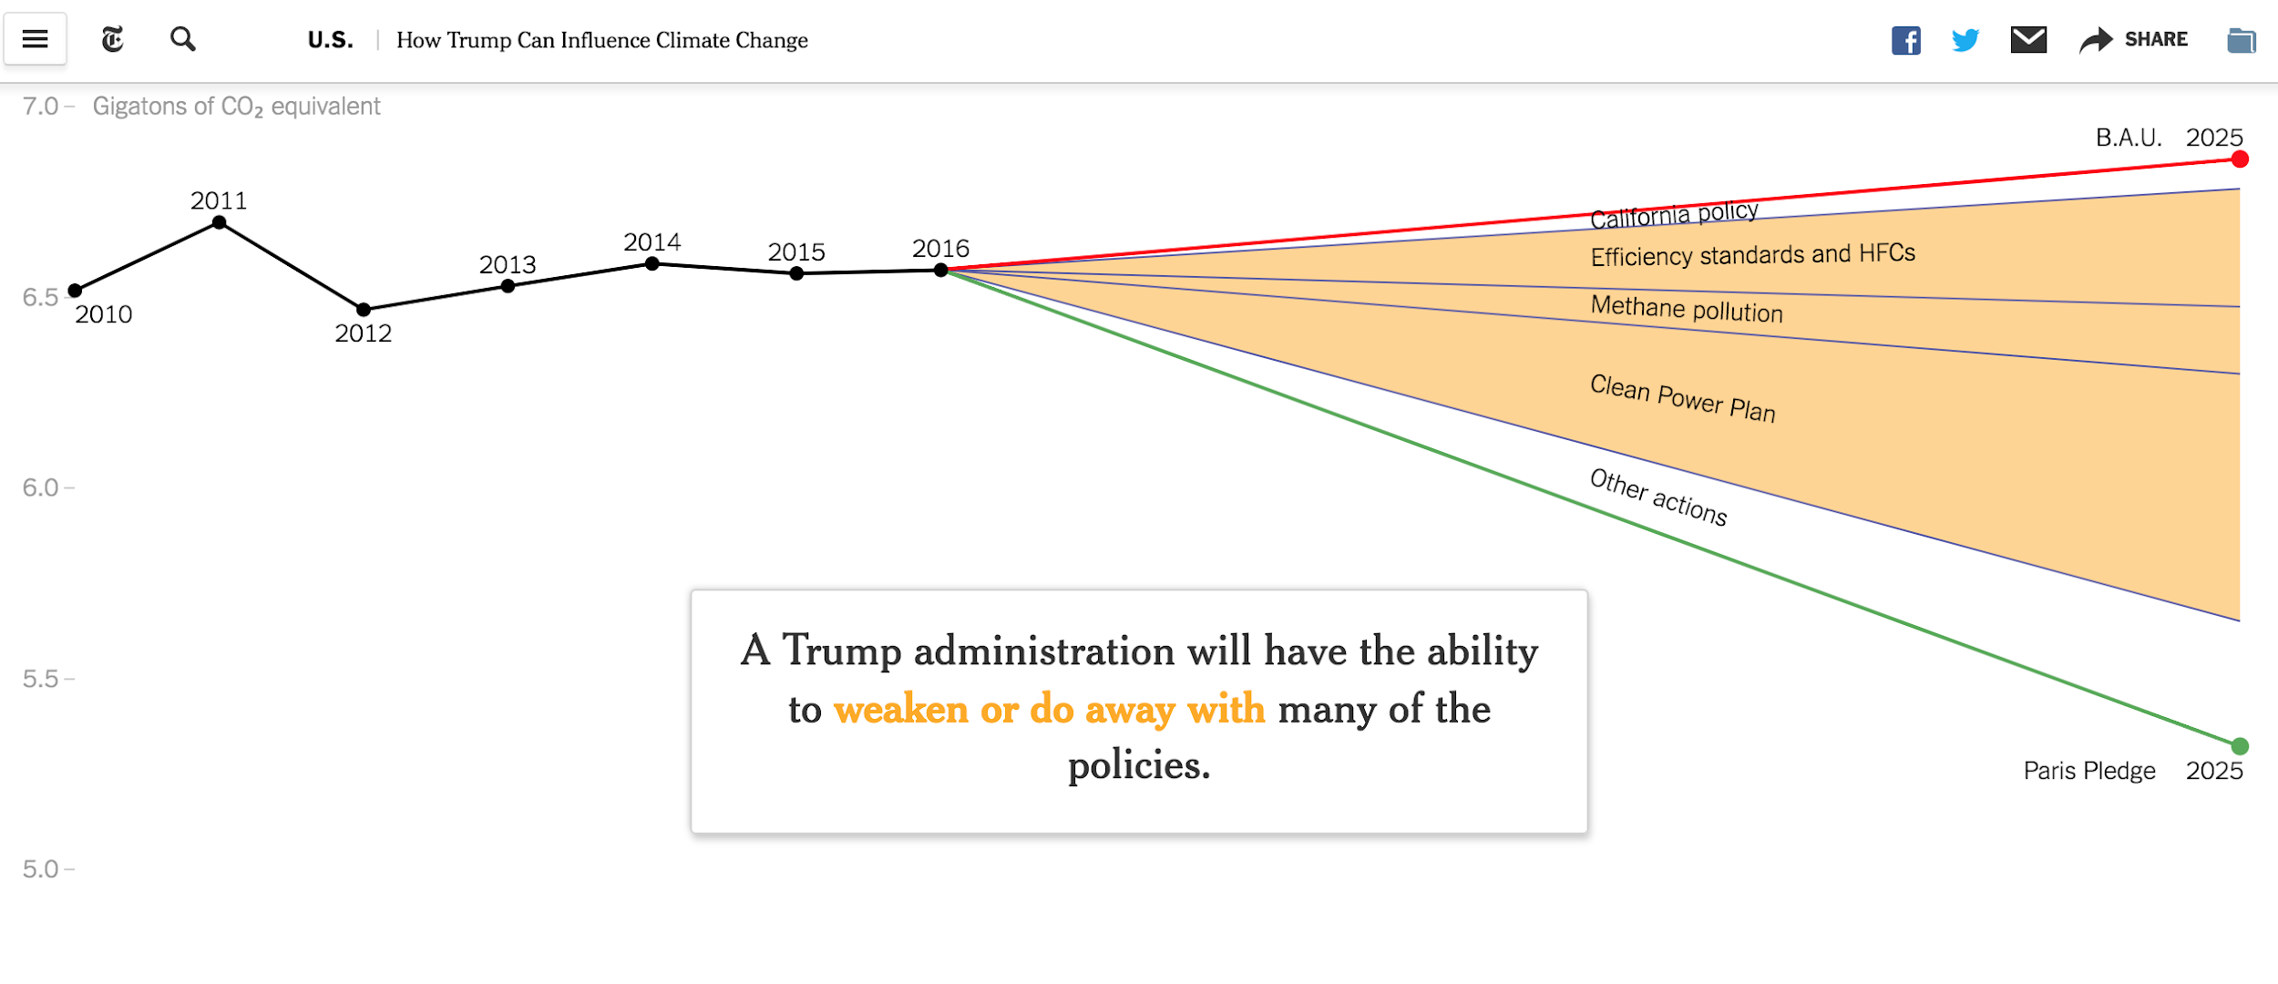
How Trump Can Influence Climate Change
https://www.nytimes.com/interactive/2016/12/08/us/trump-climate-change.html

Slide 6
U.S. government role in Climate Change
Produces and funds much of the data upon which the global climate science community depends
Agencies serve a critical and authoritative role in analyzing and communicating climate science, which informs science-based policy
Due its economic and political leadership on the international stage more broadly, U.S. policy shifts have implications far beyond its borders.
https://envirodatagov.org/wp-content/uploads/2018/01/Part-3-Changing-the-Digital-Climate.pdf#page=15&zoom=100,0,374

Slide 7
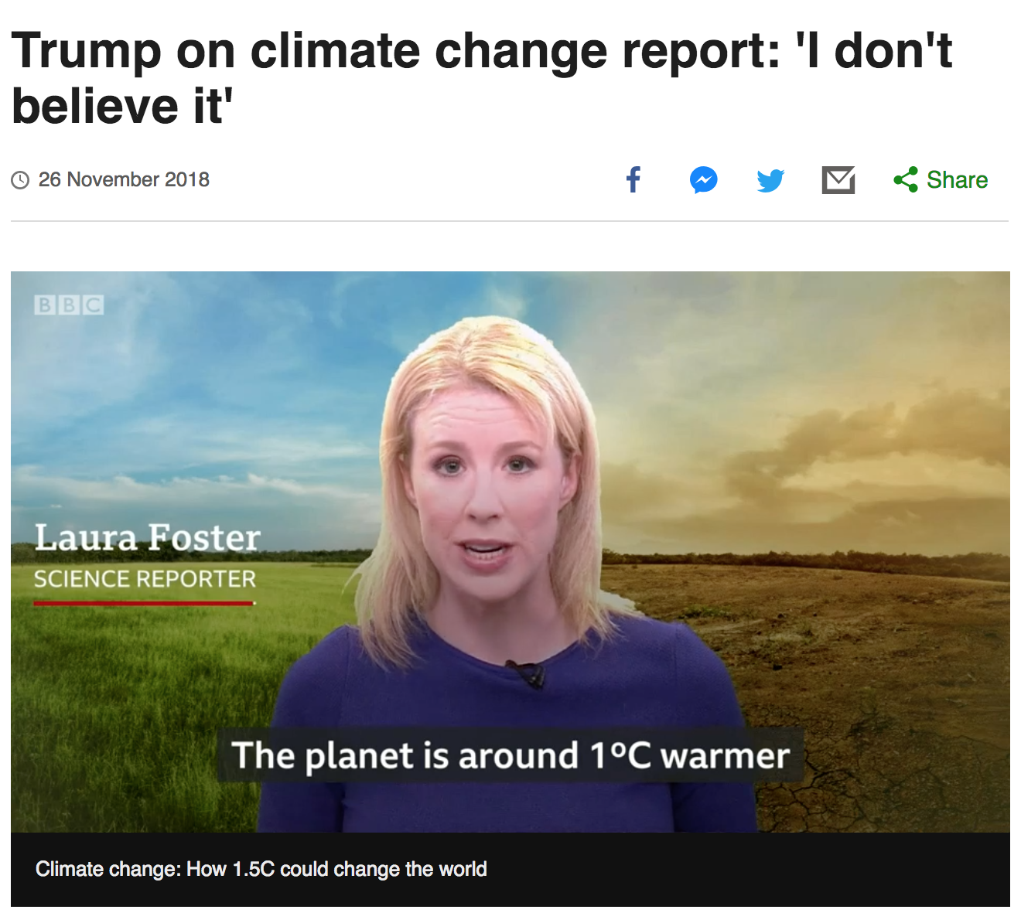
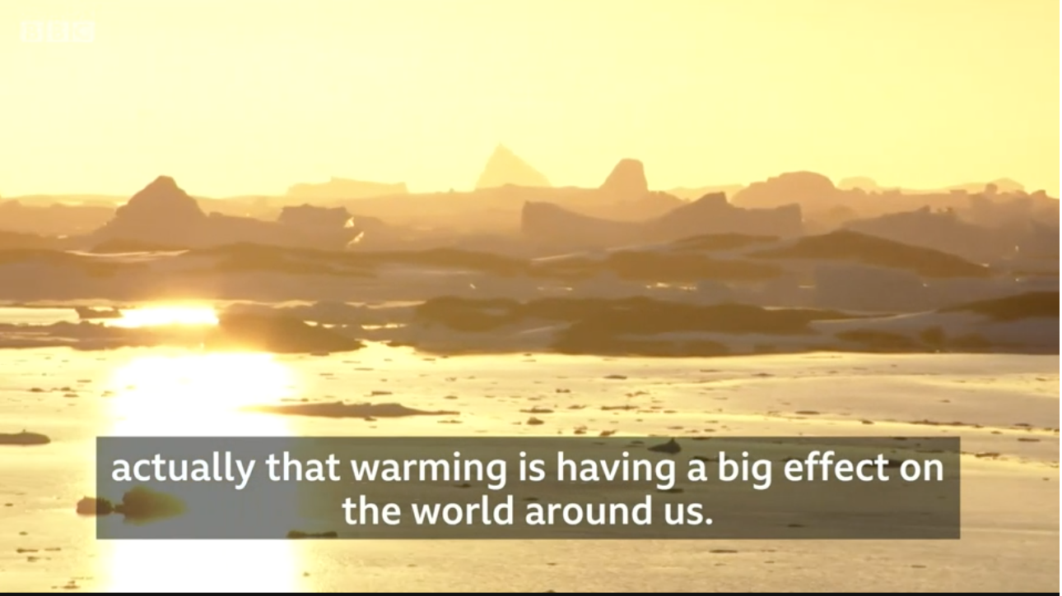

Mr. Trump refers climate change as a hoax!
https://www.bbc.com/news/world-us-canada-46351940

Slide 8
Policy Shift during first tenure of Mr. Trump
Withdraw from the landmark Paris Agreement
U.S. is now the only country not committed to “pursue efforts to limit the [global average] temperature increase to 1.5°C above pre-industrial levels”,which reduce the risks and impacts of climate change”
Ignores climate experts who warn that increasing magnitudes of warming increase the likelihood of severe, pervasive, and irreversible consequences.
National Security Strategy, 2017 confirms breaking of norms by removing climate change from a list of global threats.
https://docs.google.com/presentation/d/1FWnArIGZXhiyce0Jd7HMxfoksz-PA3JaKQ22mBiic4M/edit#slide=id.g5081bdbad1_0_82

Slide 9
Federal websites currently not aligned with climate change
White House
State Department’s Office of Global Change
Office of Energy Efficiency and Renewable Energy
Bureau of Land Management
Energy Information Administration’s (EIA) Energy Kids website
Environmental Protection Agency
https://envirodatagov.org/wp-content/uploads/2018/01/Part-3-Changing-the-Digital-Climate.pdf#page=15&zoom=100,0,374

Slide 10

Monitors tens of thousands of federal environmental websites
Assess changes to the public’s access to information and Web resources
Track language shifts.
Importance of Federal Websites
Act as interface between the public and the government
Let people better understand climate change and ways to address it via adaptation and mitigation
https://envirodatagov.org/
https://envirodatagov.org/wp-content/uploads/2018/01/Part-3-Changing-the-Digital-Climate.pdf#page=15&zoom=100,0,374

Slide 11
Confirms no removal or deletion of climate data sets from federal websites under the Trump administration
But, observes a substantial shift in how the topic of climate change and its consequences are discussed across federal websites.
Significant loss of public access to information about climate change.
https://envirodatagov.org/
https://envirodatagov.org/wp-content/uploads/2018/01/Part-3-Changing-the-Digital-Climate.pdf#page=15&zoom=100,0,374

Slide 12
Altering Climate Change presentation on the White House Website
First federal site to be changed under President Trump’s tenure - White House website
The new website omitted major topics highlighted on the Obama-era site, including climate change.
Disregard for the climate change, coupled with the lack of key staff working on climate issues, signal that climate change is not a priority.
federal websites began downplaying U.S. involvement in international climate action and removing documents pertaining to international agreements.
https://envirodatagov.org/wp-content/uploads/2018/01/Part-3-Changing-the-Digital-Climate.pdf#page=15&zoom=100,0,374

Slide 13
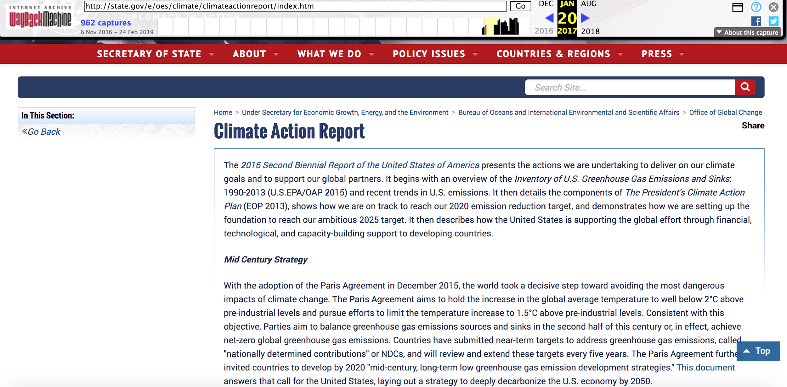
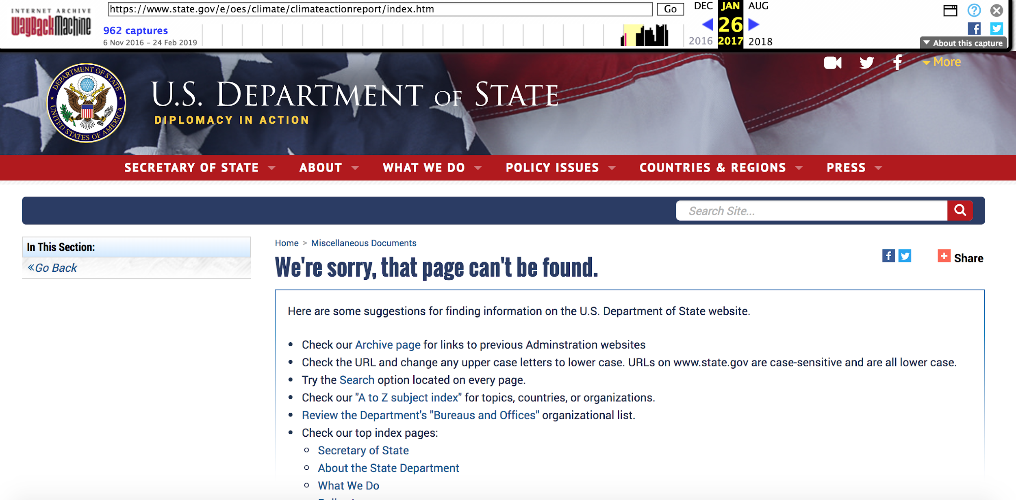
Reports pertaining to climate change removed
The State Department removed Climate Action Reports and pages describing them.
https://web.archive.org/web/20170120155019/state.gov/e/oes/climate/climateactionreport/index.htm
https://web.archive.org/web/20170126125104/https://www.state.gov/e/oes/climate/climateactionreport/index.htm

Slide 14
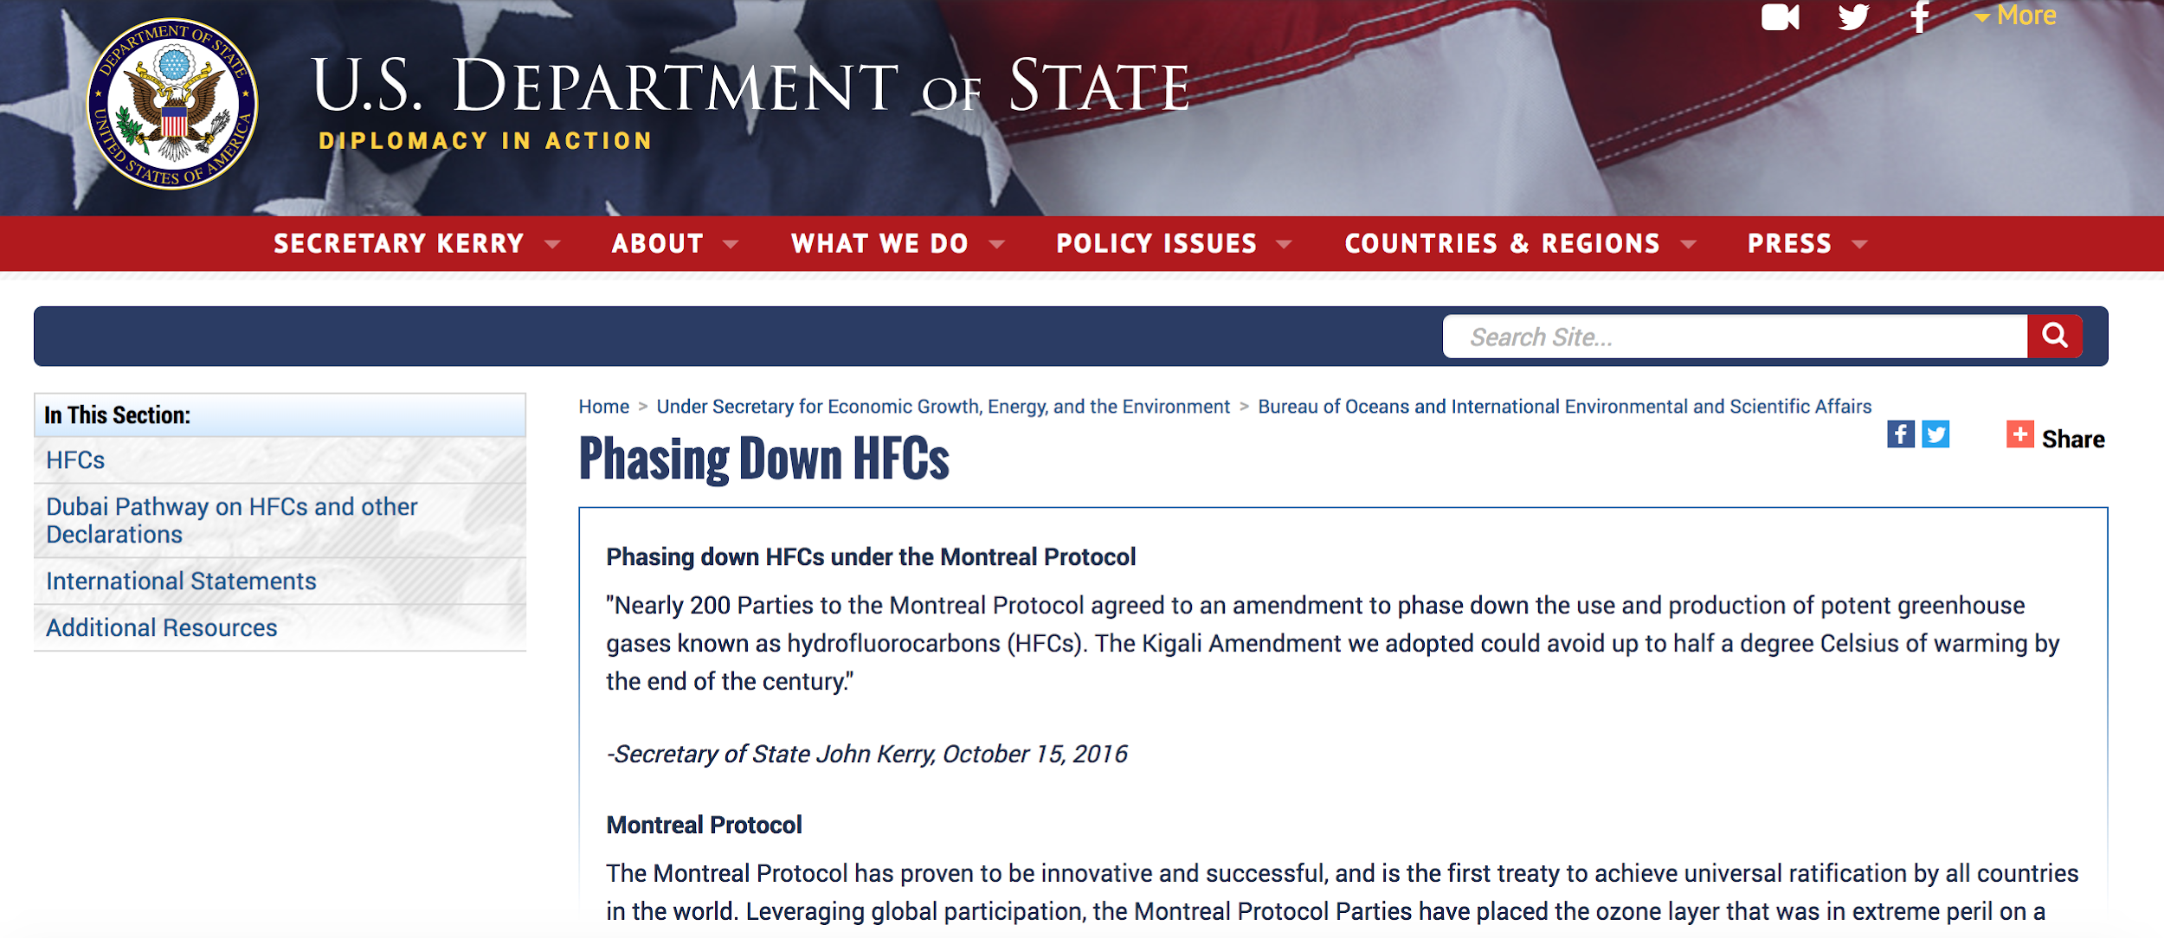
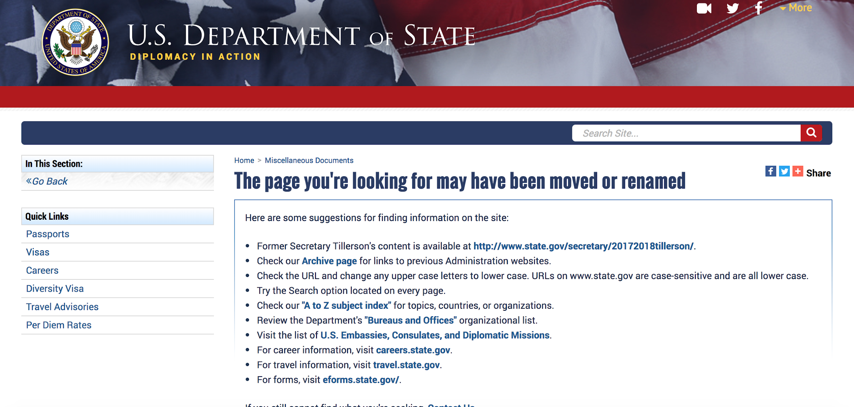
Pages describing the Montreal Protocol removed!
https://www.state.gov/e/oes/hfcs/index.htm
https://web.archive.org/web/20170114033840/https://www.state.gov/e/oes/hfcs/index.htm

Slide 15
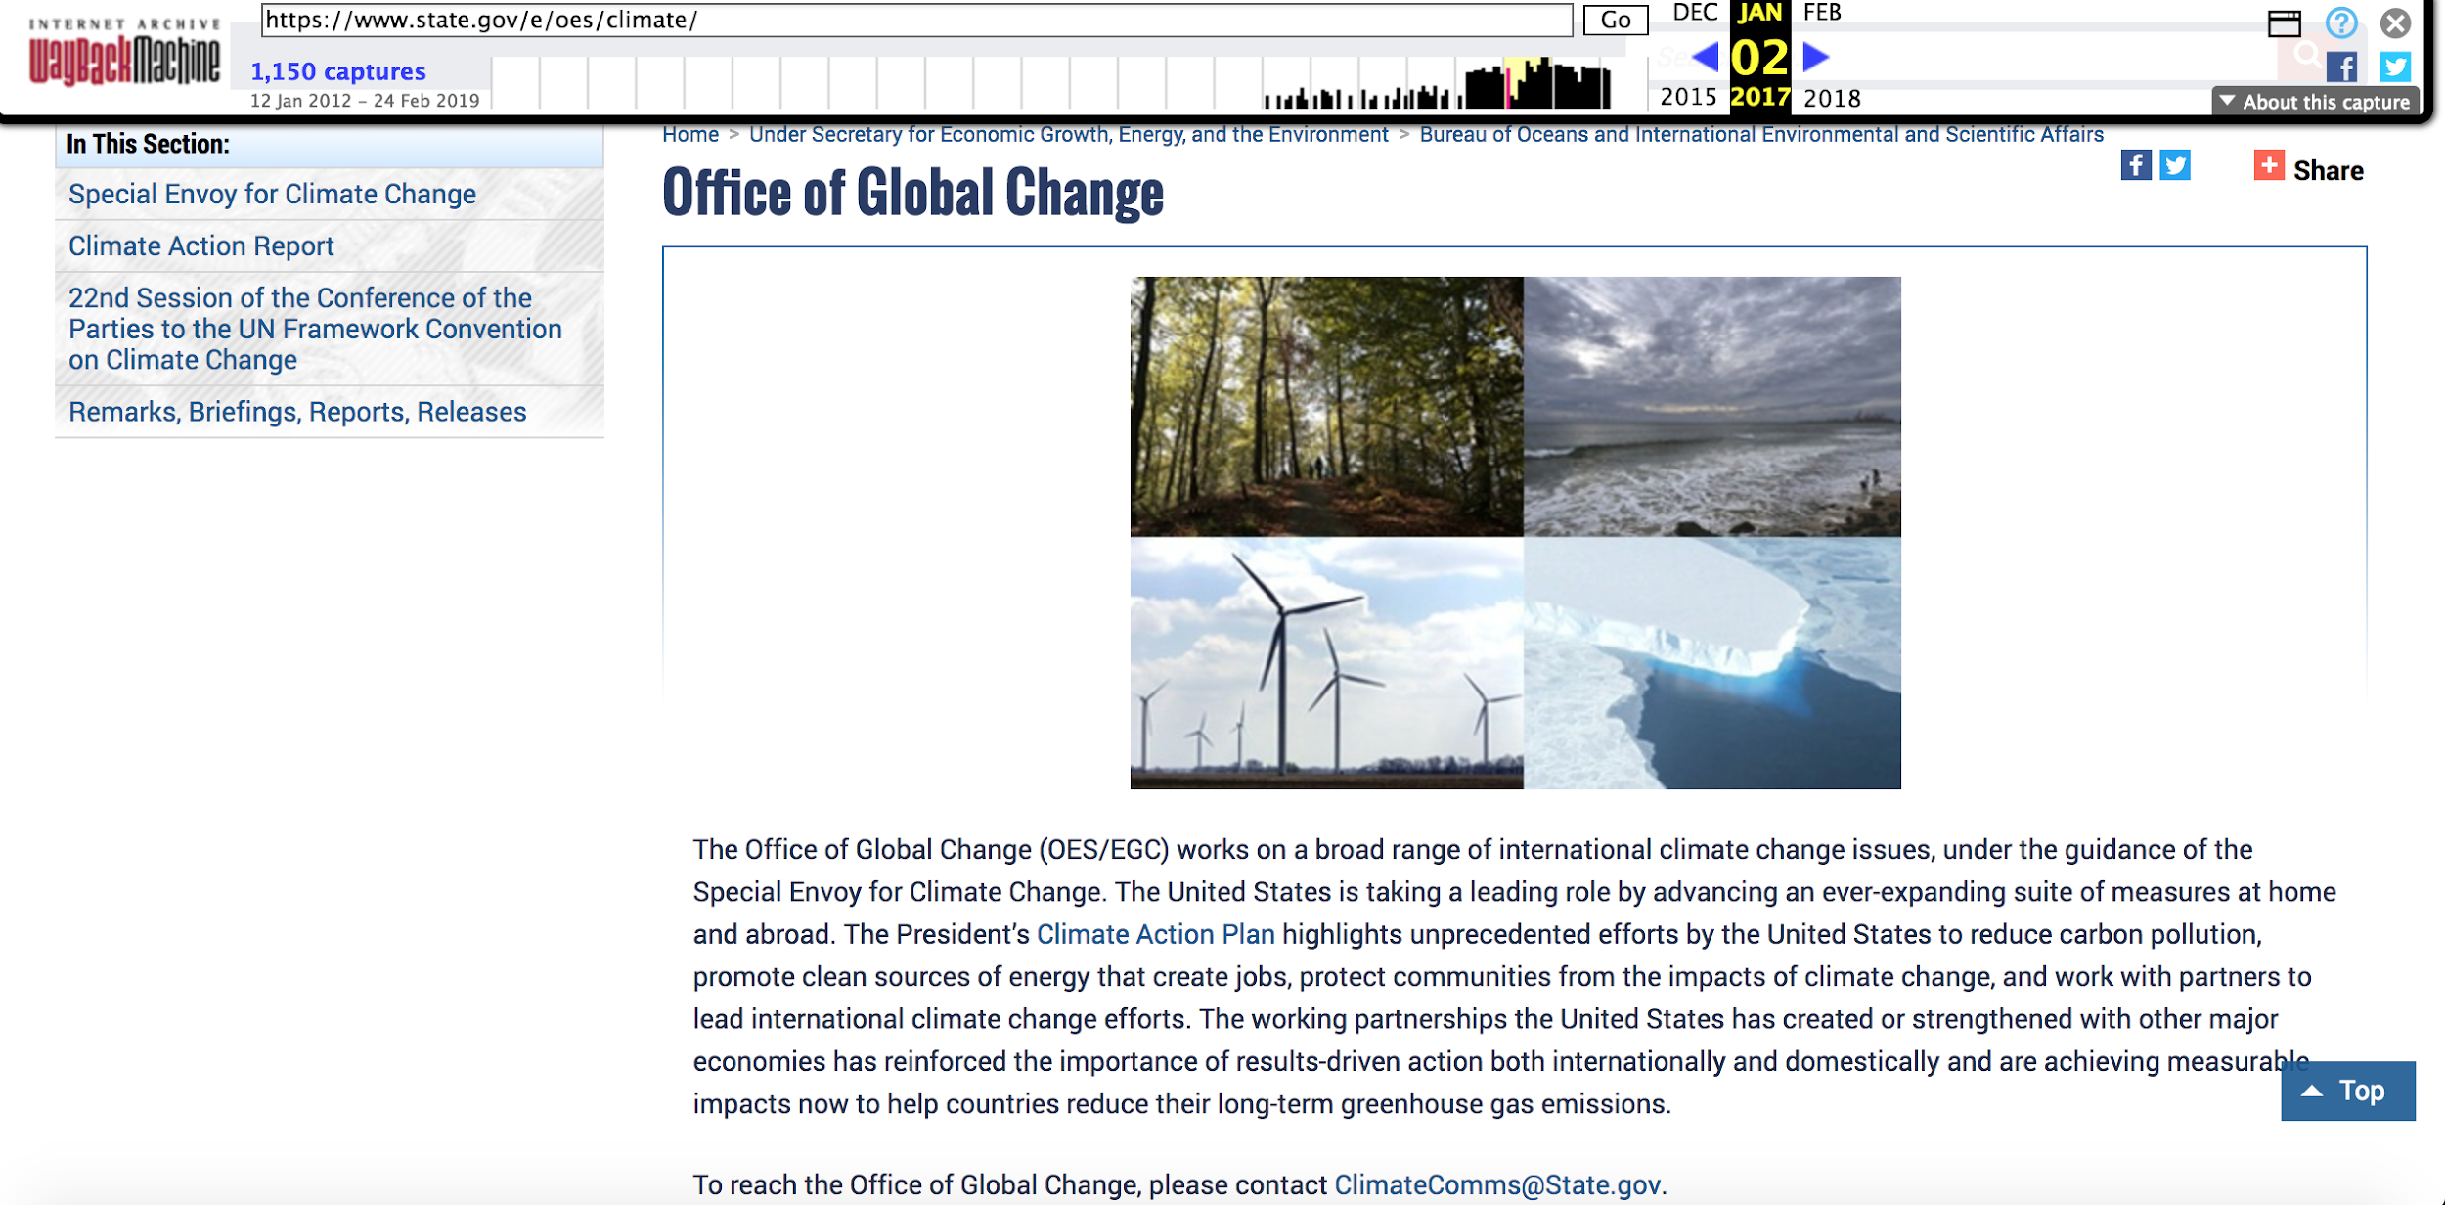
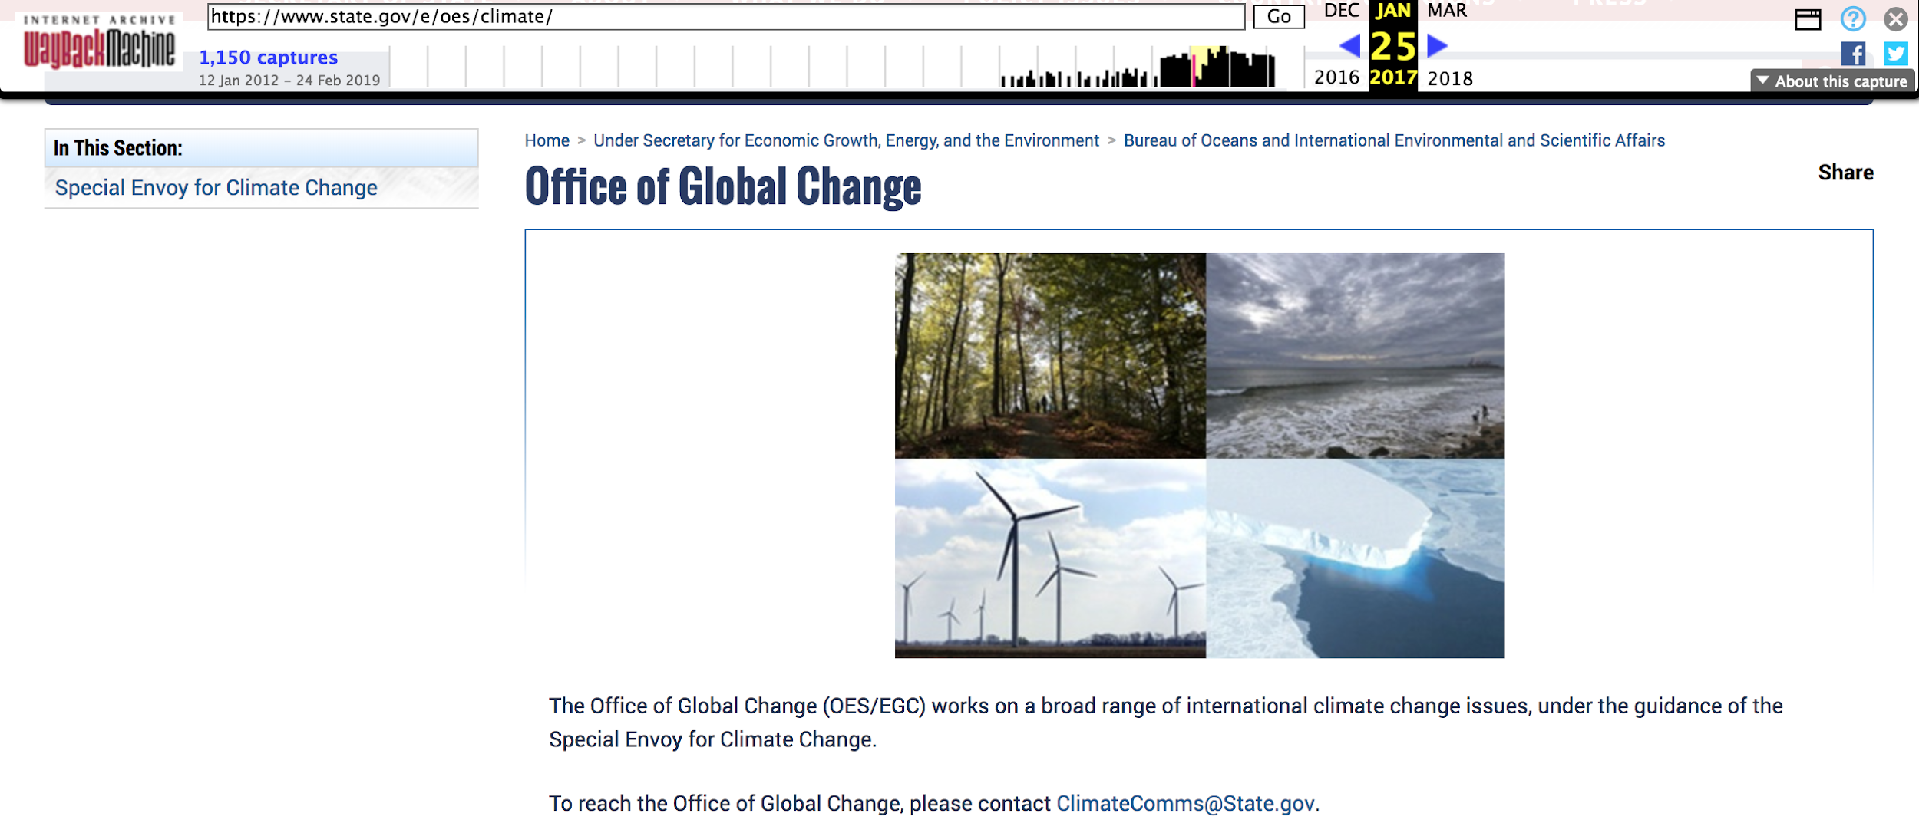
Changes to the State Department’s Office of Global Change
Removal of the entire Paragraph
https://envirodatagov.org/wp-content/uploads/2017/07/WM-CCR-6-State-Office-of-Global-Change-Updated-170412.pdf

Slide 16
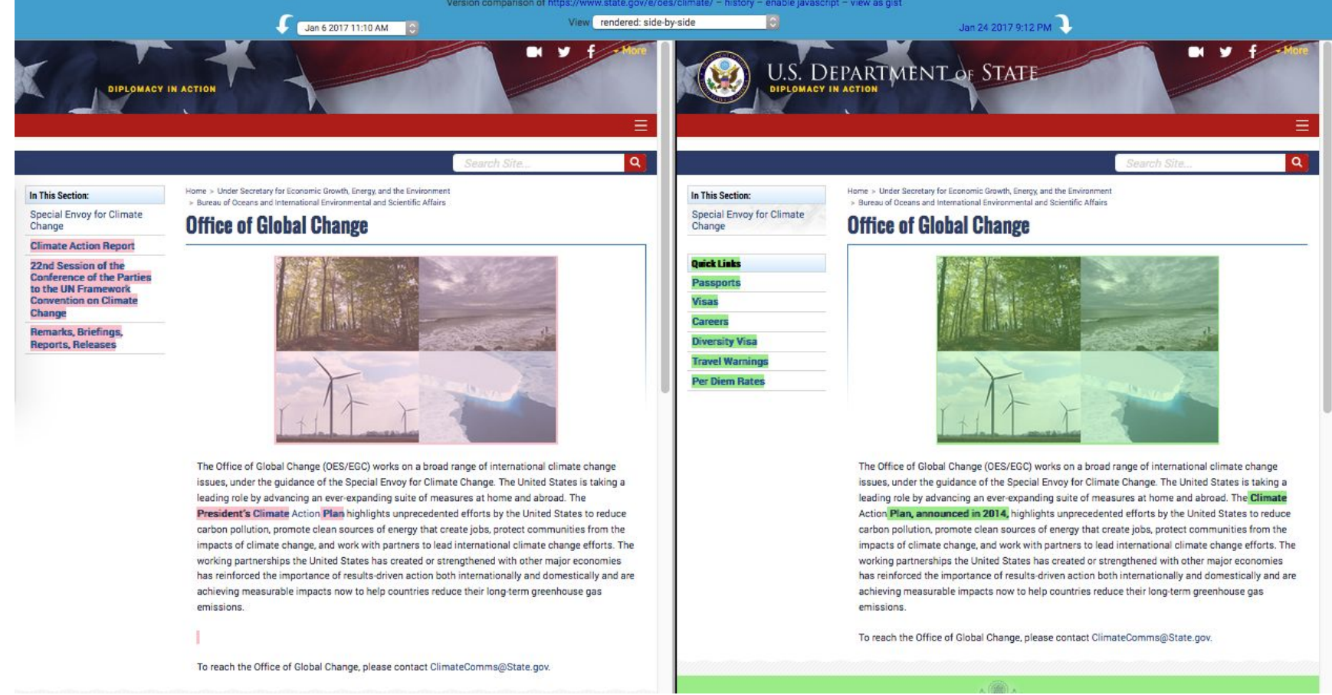
Removal of the descriptor “President’s” from “Climate Action Plan”
https://envirodatagov.org/wp-content/uploads/2017/07/WM-CCR-6-State-Office-of-Global-Change-Updated-170412.pdf

Slide 17
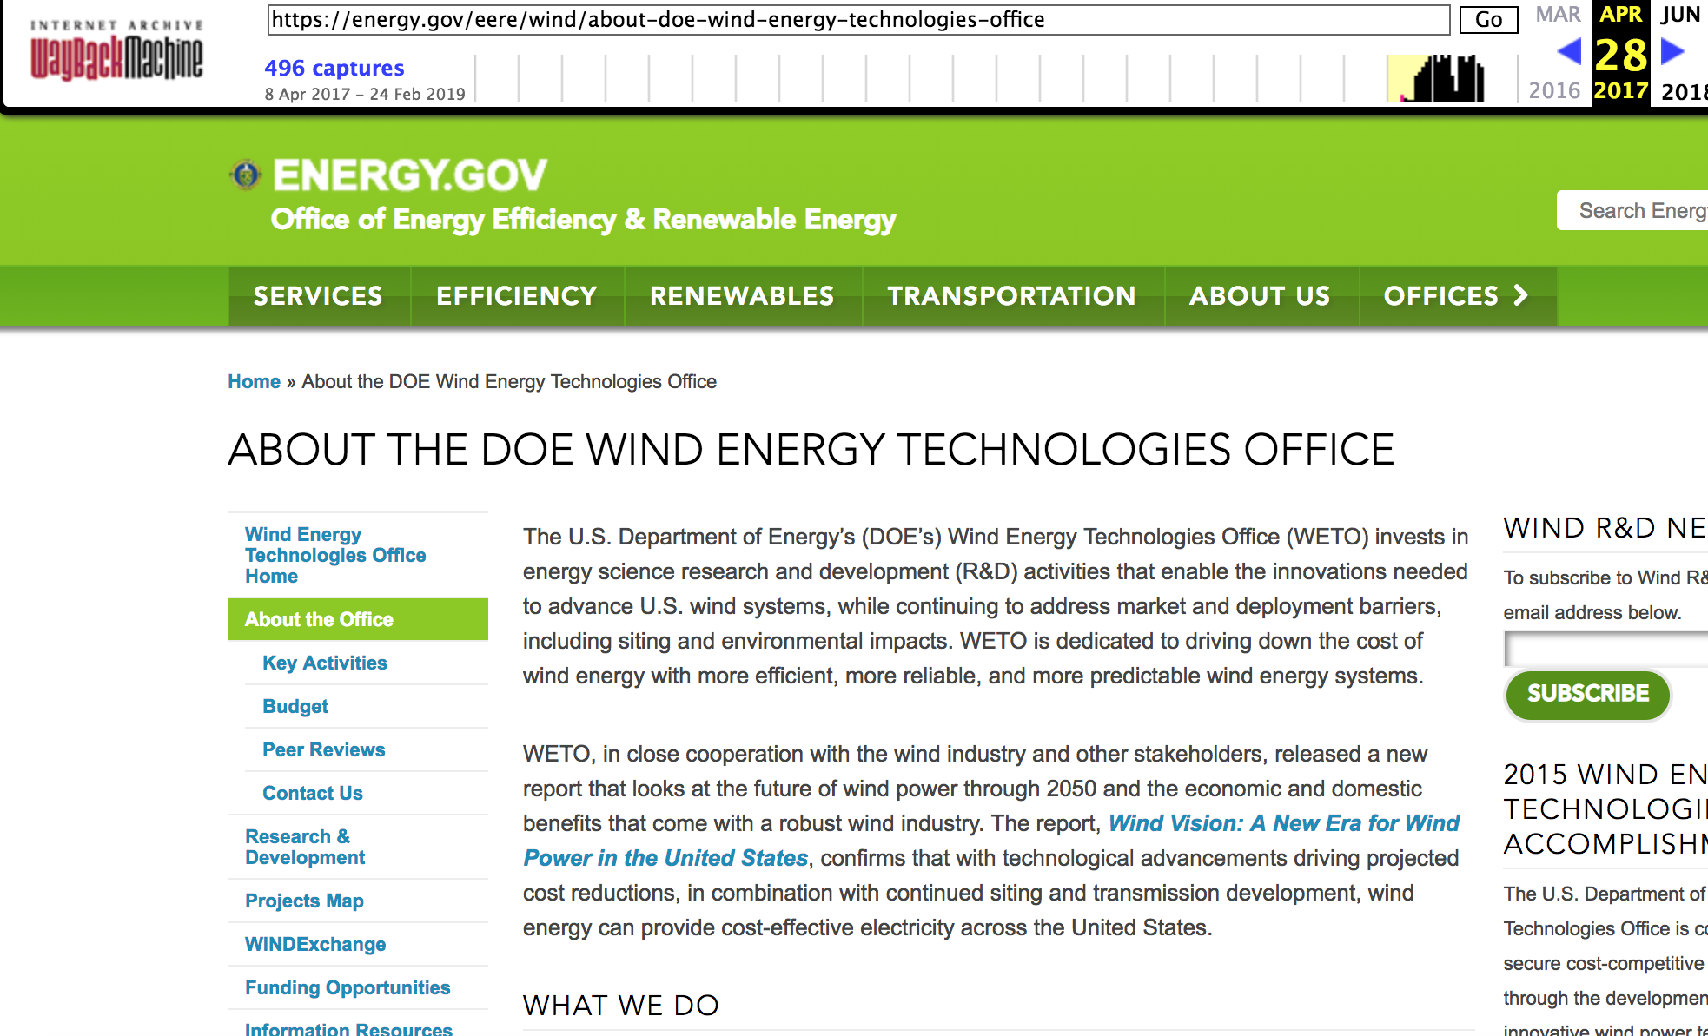
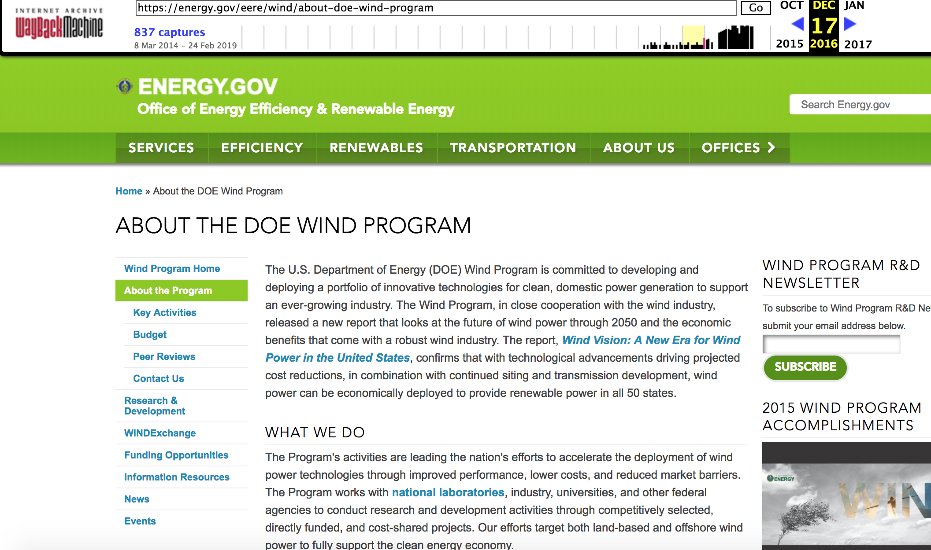
Changes to DOE’s Official Web Pages
https://web.archive.org/web/20161217183720/https://energy.gov/eere/wind/about-doe-wind-program
https://web.archive.org/web/20170428151720/https://energy.gov/eere/wind/about-doe-wind-energy-technologies-office
https://envirodatagov.org/wp-content/uploads/2017/07/WM-CCR-12-EERE-Wind-Technologies-Office-170419.pdf

Slide 18
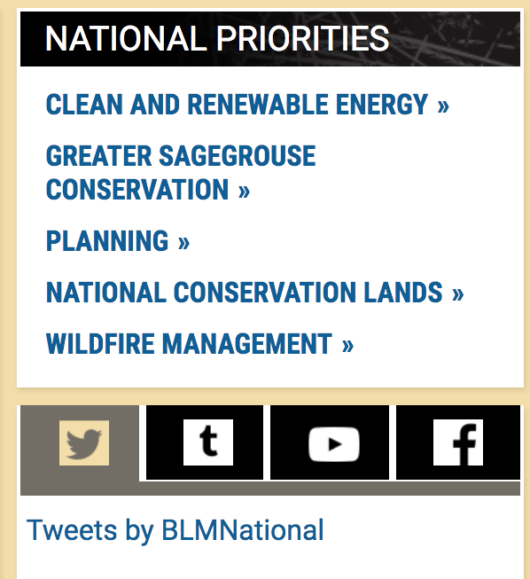
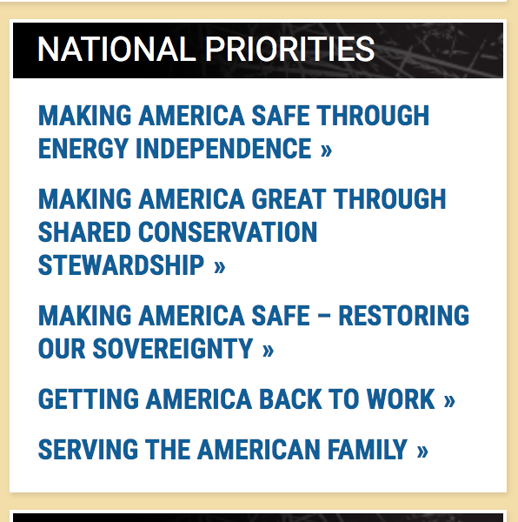
BLM Website Changes: Feb 7,2017 (vs) November 26, 2017
https://web.archive.org/web/20170207060252/https://www.blm.gov/about
https://web.archive.org/web/20171126184421/https://www.blm.gov/about

Slide 19
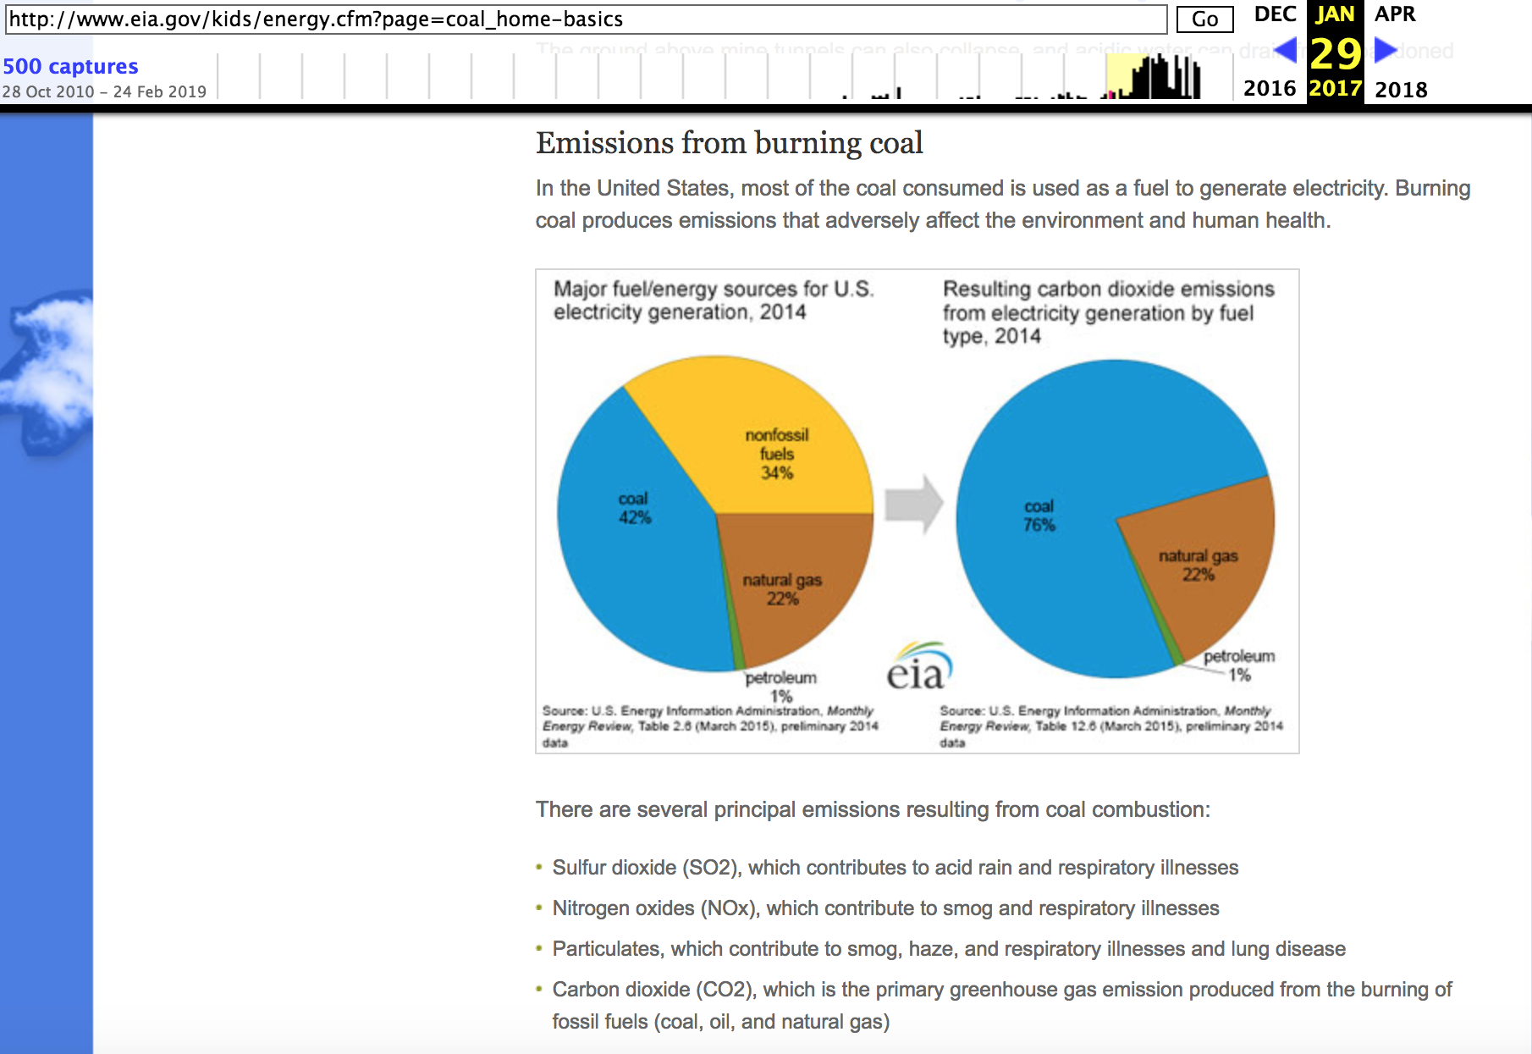
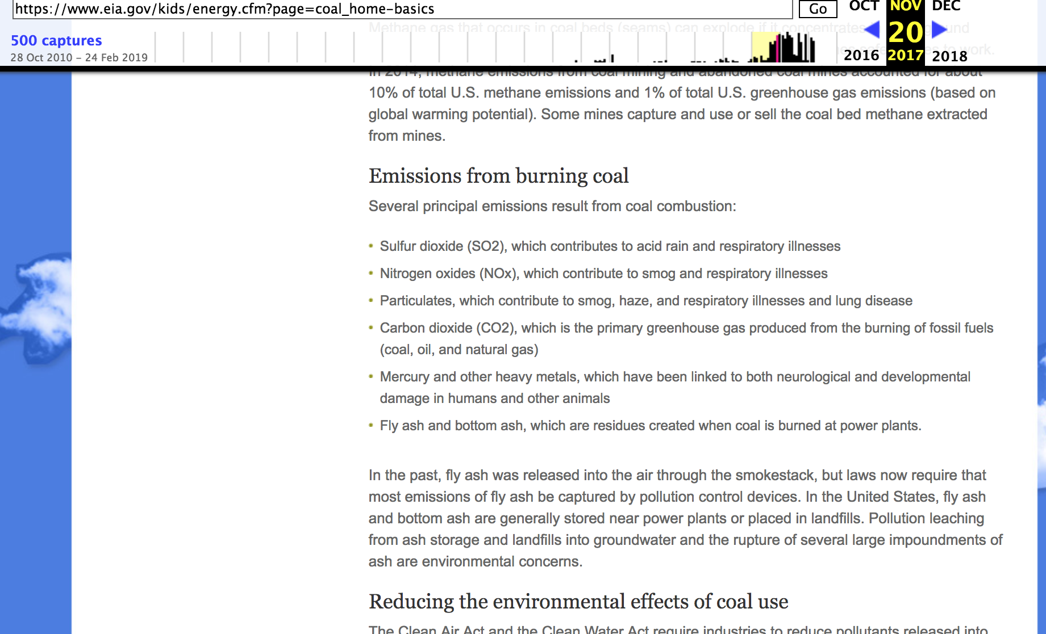
Energy Information Administration’s (EIA) Energy Kids website.
A sentence and graph about coal removed from EIA website
https://web.archive.org/web/20170129065042/http://www.eia.gov/kids/energy.cfm?page=coal_home-basics
https://web.archive.org/web/20171120190803/https://www.eia.gov/kids/energy.cfm?page=coal_home-basics
https://envirodatagov.org/wp-content/uploads/2018/01/Part-3-Changing-the-Digital-Climate.pdf#page=15&zoom=100,0,374

Slide 20
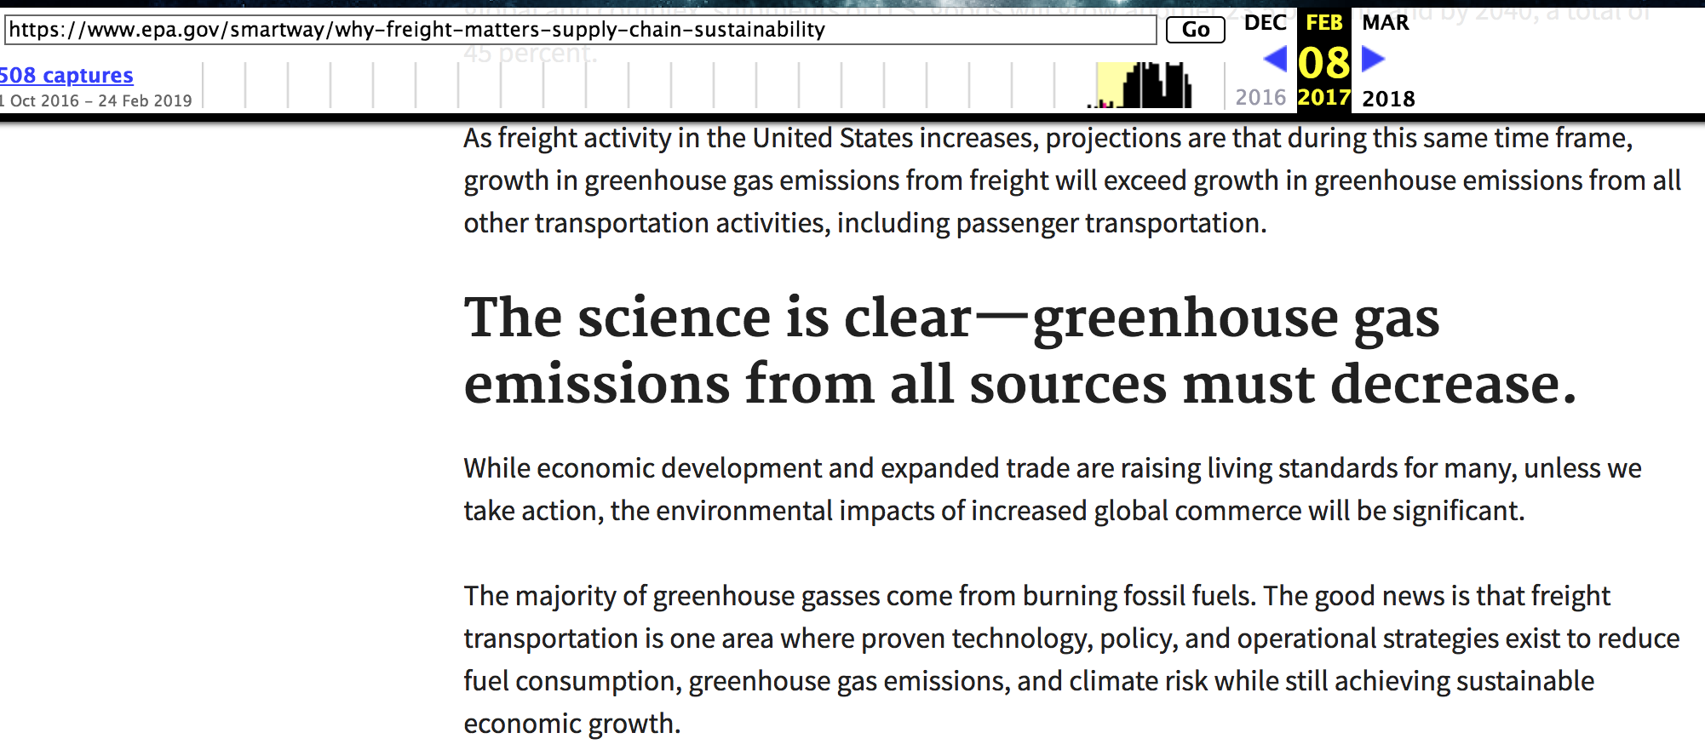
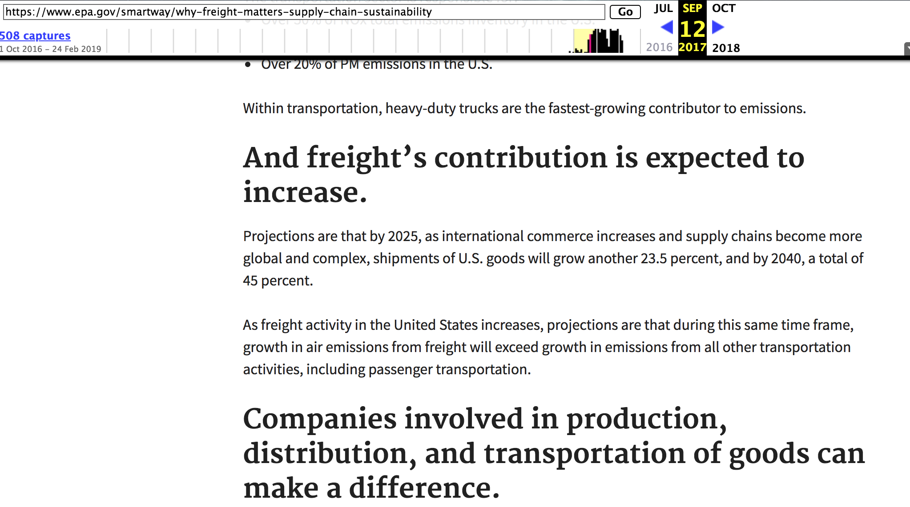
Changes to EPA’s SmartWay website
Removal of entire section titled “The science is clear - greenhouse gas emissions from all sources must decrease”
https://web.archive.org/web/20170208122205/https://www.epa.gov/smartway/why-freight-matters-supply-chain-sustainability
https://web.archive.org/web/20170912191105/https://www.epa.gov/smartway/why-freight-matters-supply-chain-sustainability

Slide 21
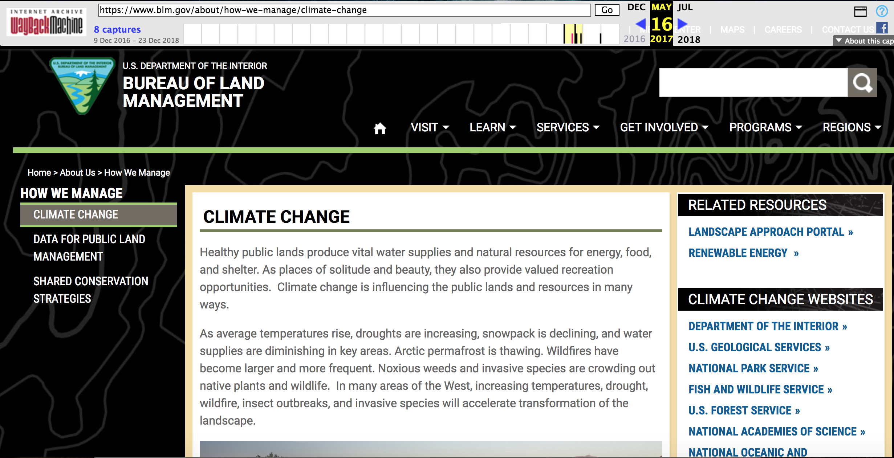
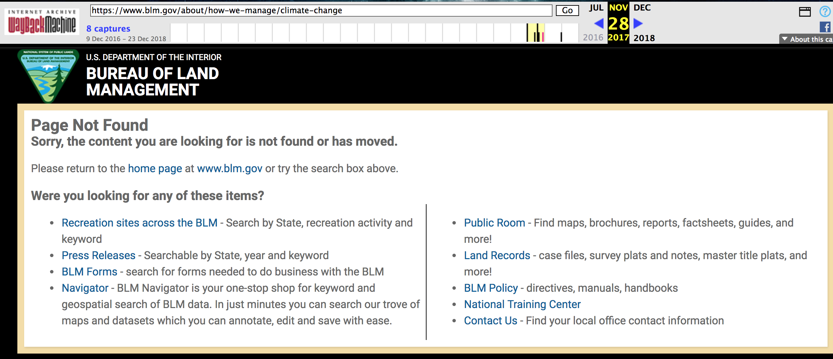
Removal of the Department of the Interior’s Bureau of Land Management Climate Change page
https://web.archive.org/web/20170516035341/https://www.blm.gov/about/how-we-manage/climate-change
https://web.archive.org/web/20171128175741/https://www.blm.gov/about/how-we-manage/climate-change

Slide 22
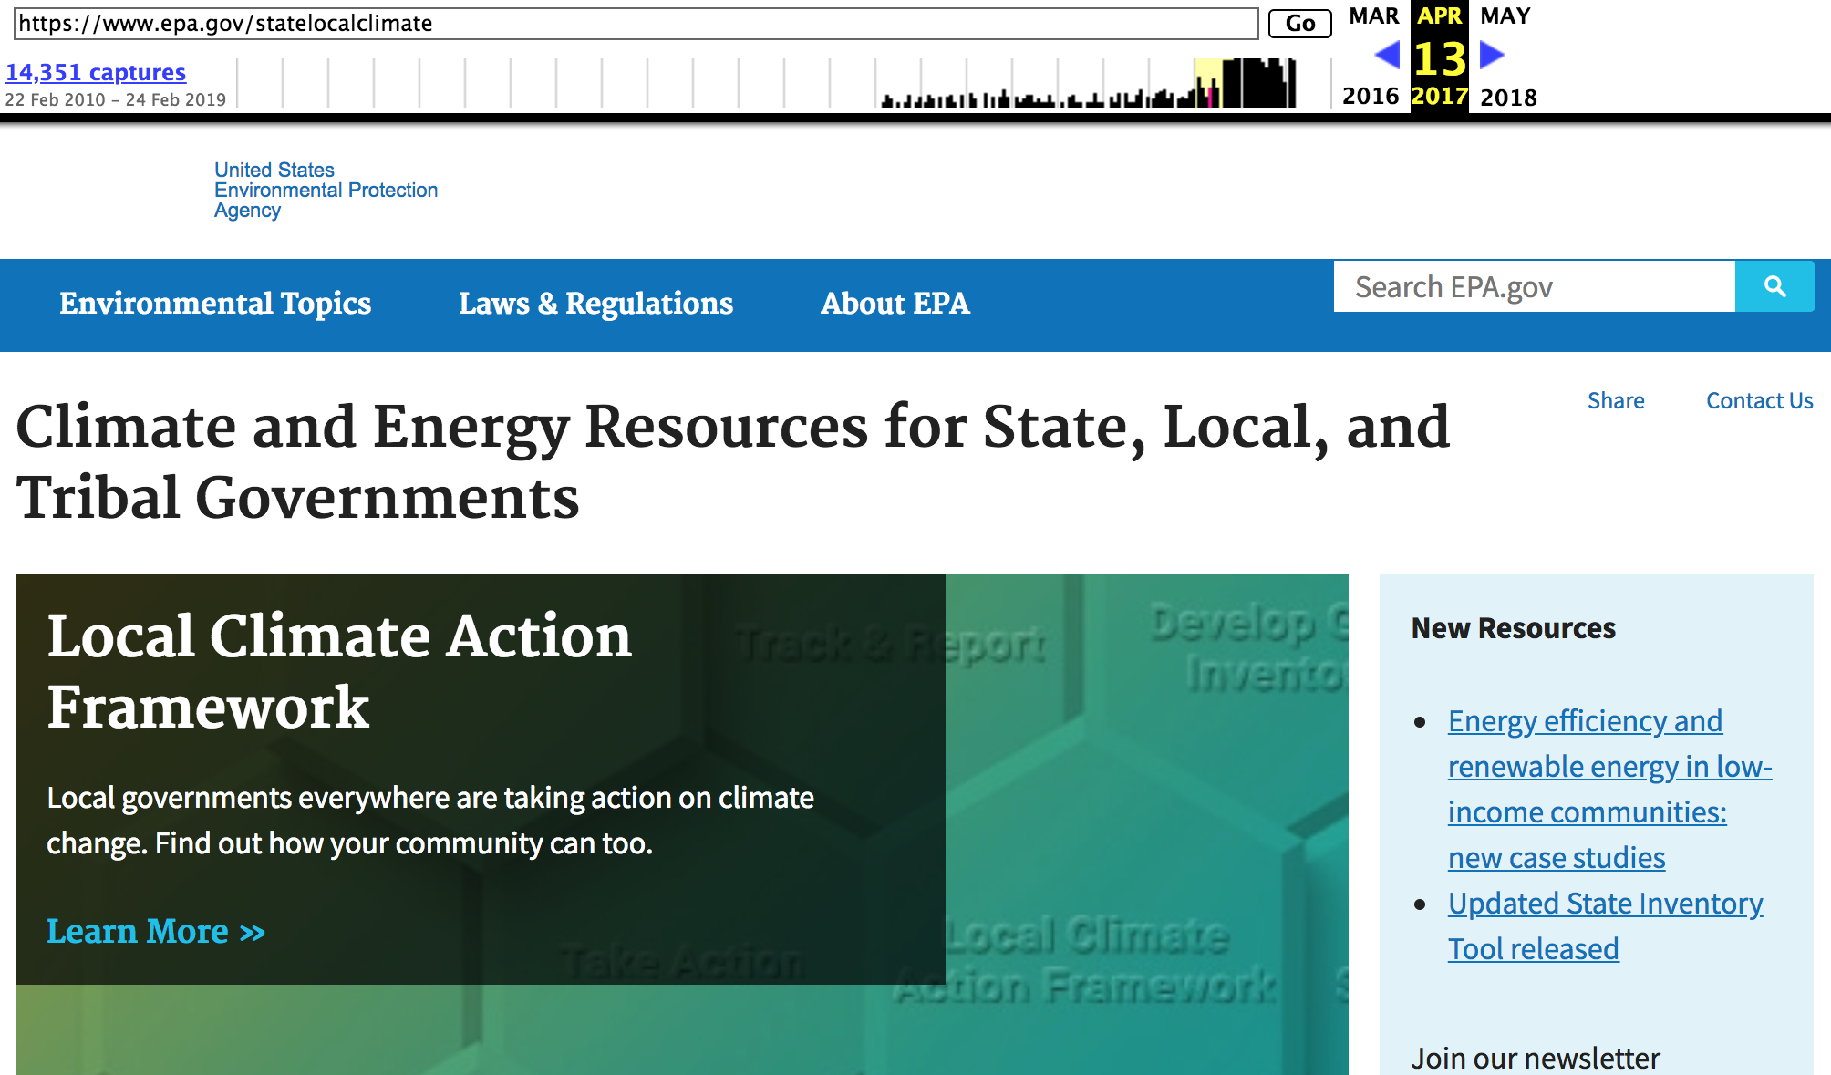
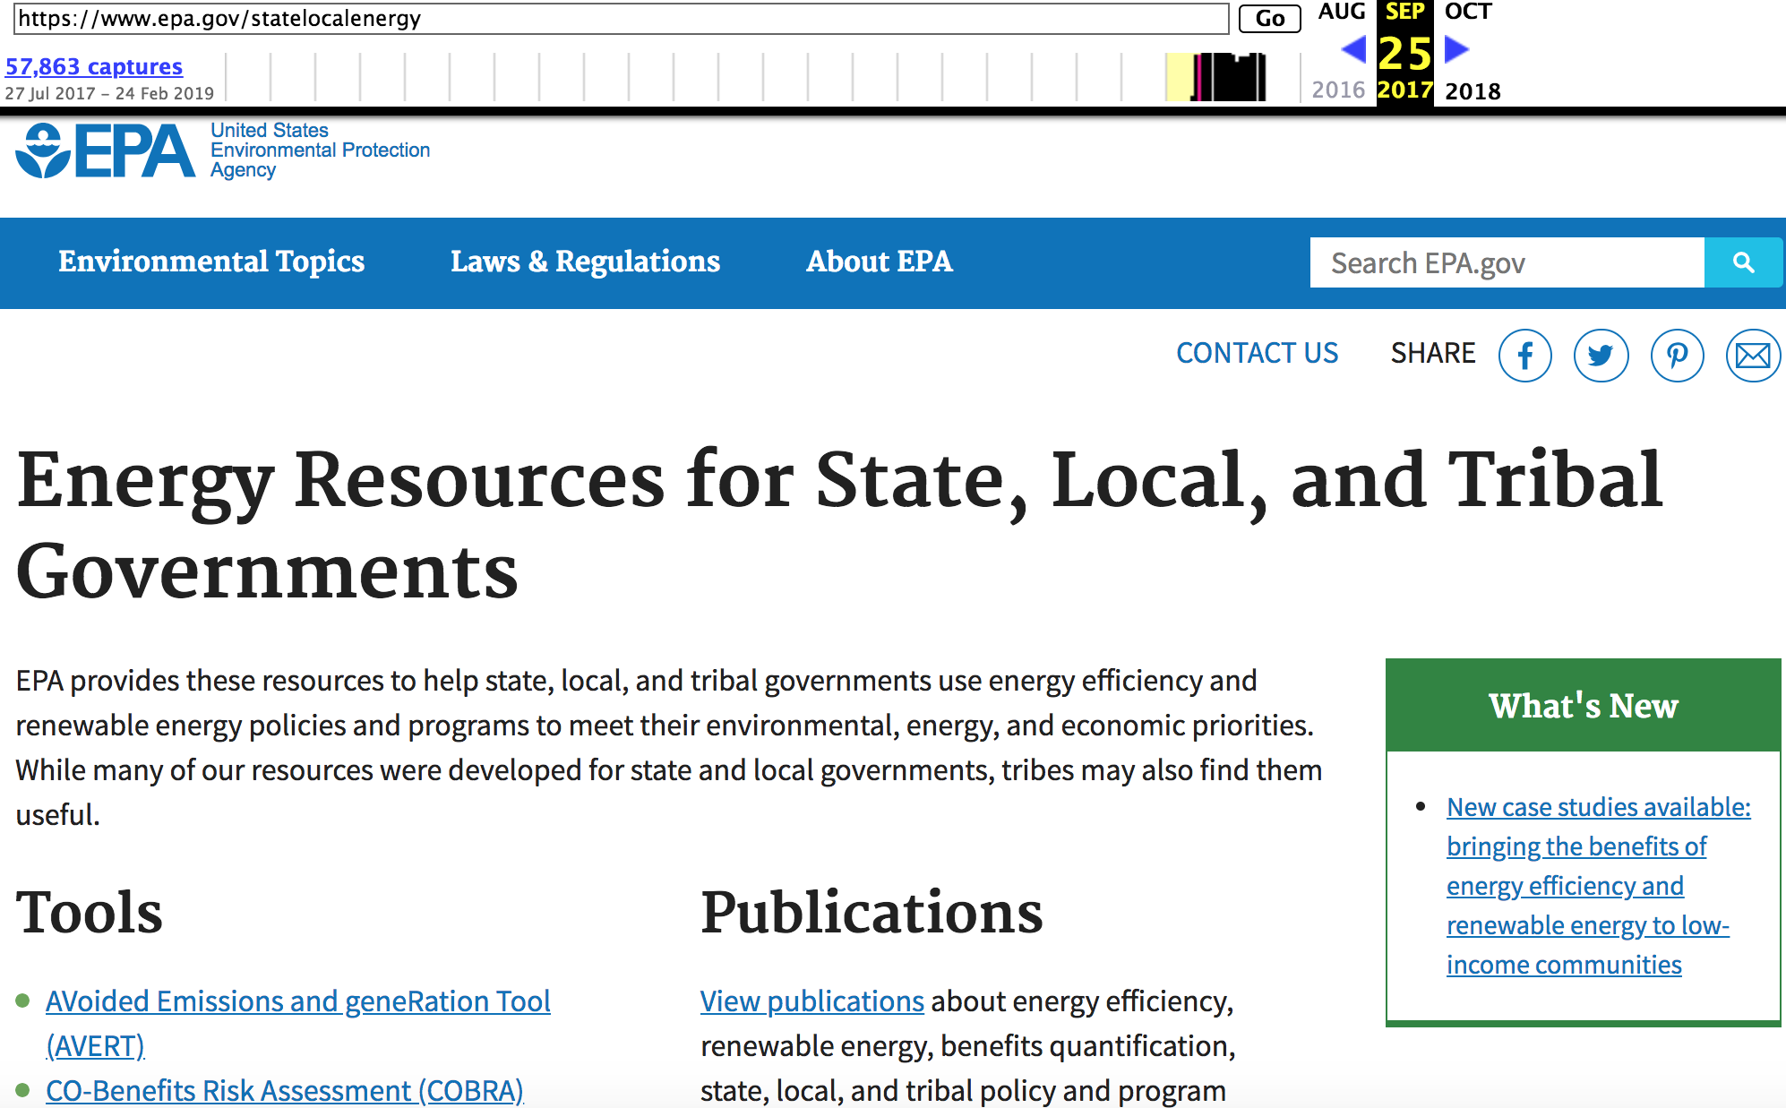
Alteration to EPA Climate Web Content
Replacement of the “Climate and Energy Resources for State, Local, and Tribal Governments” website with another that omits climate information.
https://web.archive.org/web/20170413052024/https://www.epa.gov/statelocalclimate
https://web.archive.org/web/20170925022922/https://www.epa.gov/statelocalenergy

Slide 23
Significance of Changes to Federal Web Content
People visit federal websites, however, they see only the current version, not the record and progression of changes that lead up to it
They have no way to see how their access to information has been altered.
Changes have made it harder for the public to gain access to years of well-researched and organized information paid for by their tax dollars
Gain information that is crucial in helping inform the important discussions on how to best mitigate and adapt to the effects of climate change.
https://envirodatagov.org/wp-content/uploads/2018/01/Part-3-Changing-the-Digital-Climate.pdf#page=15&zoom=100,0,374

Slide 24
Takeaway
Transparency: should detail the scope of the pages that will be affected and clearly explain the reason for planned alterations.
Responsible Web archiving: agencies should not alter or reduce access to Web content before they have created a log to thoroughly document and ensure that the content is preserved and made accessible through a public archive.
Valuing Web resources: Web resources should be valued in terms of their educational importance and advancement of scientific and policy research.
Distributed Web archiving: Agencies should rethink the way we organize, steward, and distribute data, Web resources, and online information.
Environmental data justice: create digital infrastructure through which communities can determine what kinds of data are collected and presented
https://envirodatagov.org/wp-content/uploads/2018/01/Part-3-Changing-the-Digital-Climate.pdf#page=15&zoom=100,0,374
@WebSciDL
@PuneethBikks

